Slide 1

RESPONSIVE BLOG WEBSITE
Project Incharge:
Ms. Anjali Arora
Guided By:
Ms. Anubha Dhaka
Presented By:
Deepanshu(2100140100031)
Divyanshi Sharma(2100140100033)
Shreya Dixit(2100140100100)

Slide 2
TABLE OF CONTENTS
Introduction
Problem Statement
Motivation
Hypothesis Development
Modules
Technologies Used
Requirements
References

Slide 3
INTRODUCTION
A responsive website is designed to adjust to the screen it is being viewed on. As, a result it looks incredible on any mobile phones, tablets and desktop.
It makes websites more user friendly because they are easier for clients to interact .In todays world we see that a use of mobile phones is much more increased as compared to other devices,so for creating a website a mobile user is focused first as compared to other device users.
A responsive web design is about using HTML,Javascript and CSS to automatically resize, hide, shrink, or enlarge a website to make it good in all devices. In simple words we can say that it can provide a better visual experience to the website users.

Slide 4
PROBLEM STATEMENT
To make it easier for the users to find information they are looking and encourages them to stay on our site for long time.
In most of the websites we usually have to do login or sign in and due to this our data is reached to the other person and he may can miss use it and due to this there is a high risk of hacking ,and different internet frauds,scams etc.

Slide 5
MOTIVATION
The main motivation behind this project is that we’ve grown in the era where technology is evolving at its high peak. We daily see new technologies which are making our livelihood more easier.
At this point we thought it would be the best to develop our own responsive website as it contains motivational quotes which encourages people to do their task efficiently and with full determination. Apart from it contains current affairs which helps in enhancing our knowledge.

Slide 6
Hypothesis Development
H[1]: “There is a significant difference of total scrolls used while exploring home functionality between different designs on different devices”
H[2] : “There is a significant difference of content readability quality between different designs on different devices”.
H[3]: “There is significant difference of enjoyment of using website between different designs on different devices”

Slide 7




MODULES
Technical Quiz
Compiler
Notes
Current Affairs

Slide 8




TECHNOLOGY USED
CSS
JAVASCRIPT
HTML

Slide 9
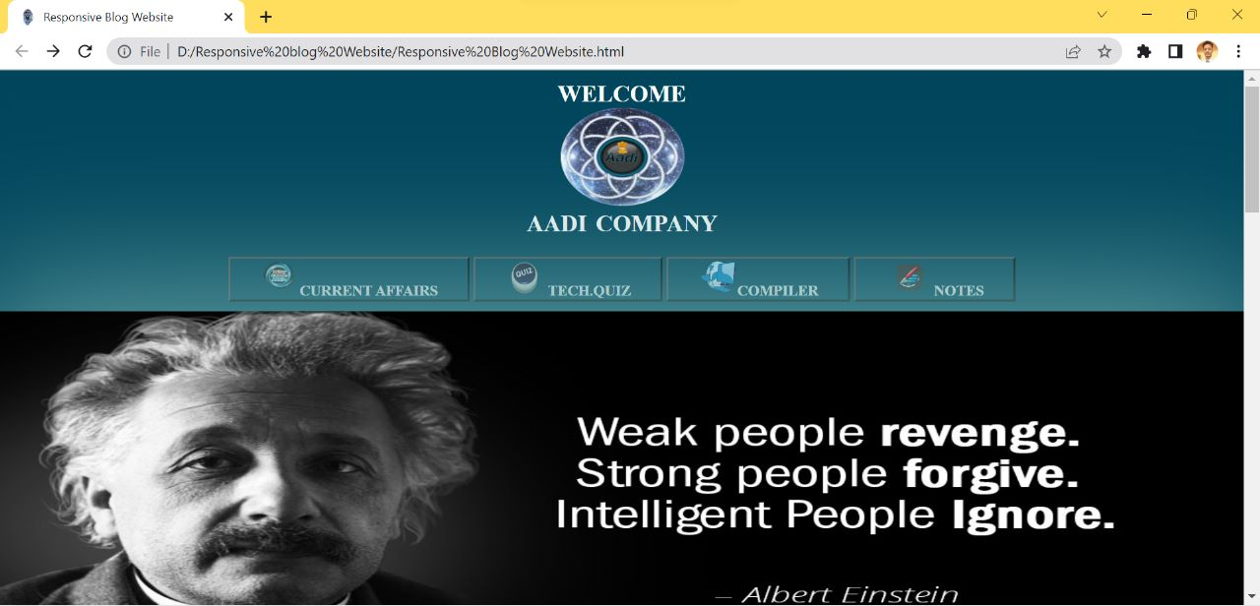

Slide 10
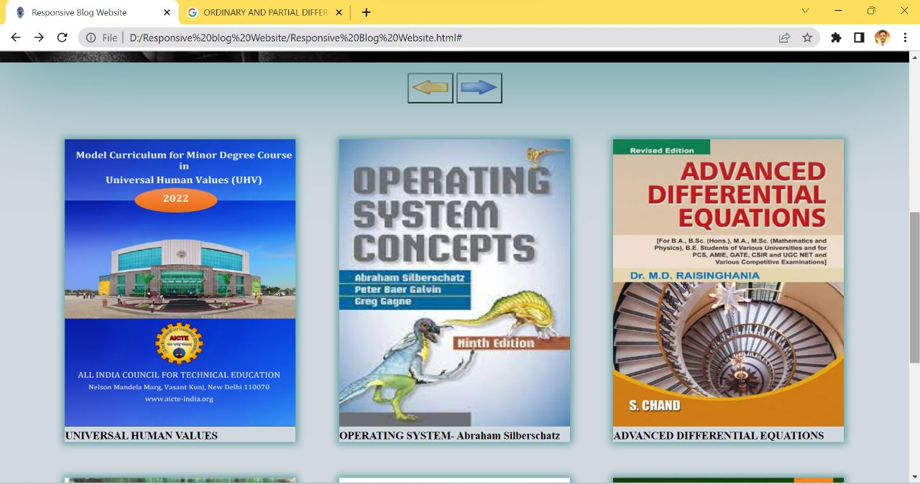

Slide 11
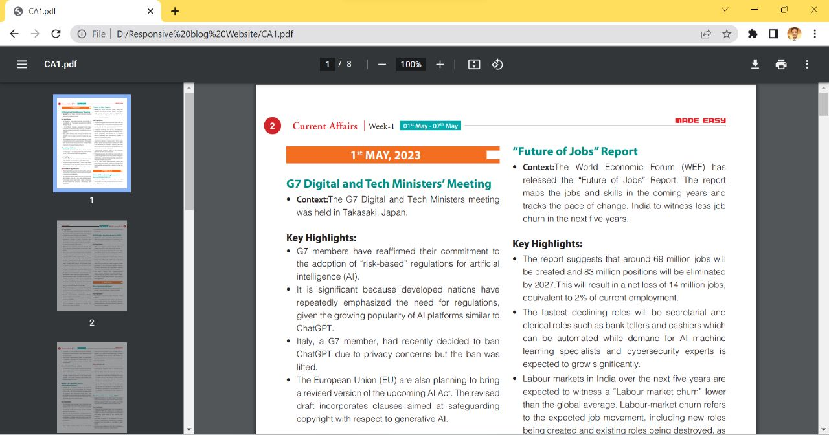

Slide 12
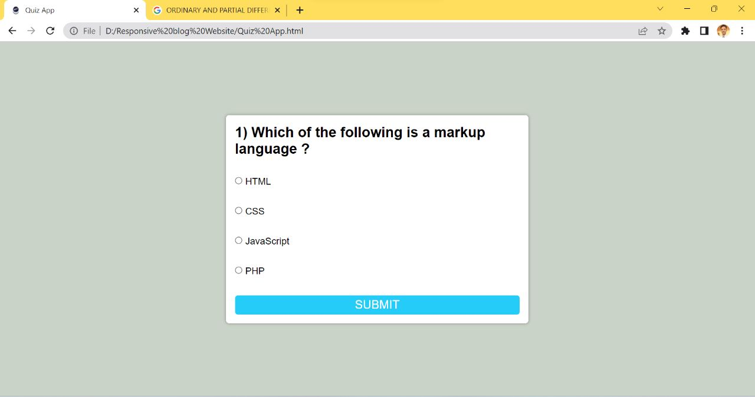

Slide 13
REQUIREMENT AND SPECIFICATIONS
Hardware Requirement/Specification
External Hard Drive
Laptop
Network Server
Mobile device

Slide 14
REFERENCES
P. Cashmore, Why 2013 Is the Year of Responsive Web Design, 2012, http://mashable.com/2012/12/11/responsive-web-design
J. A. Sanchez, Infographic: 2013 The Year of Responsive Design, 2012, http://www.uberflip.com/blog/infographic-2013-the-yearof-responsive-design
Bernoff J. , People don't trust company blogs: What you should do about it , 2008,
http://blogs.forrester.com/

Slide 15


